Slide 1
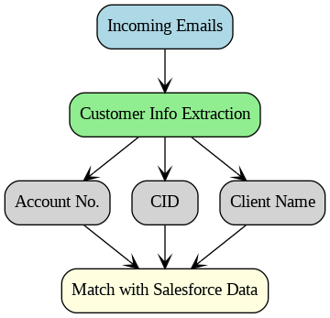
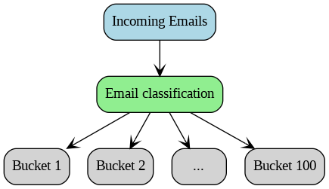
Indexing Automation
Indexing Automation involves handling emails from internal officers or external clients containing specific requests for service officers to fulfill.
Segment+
Coverage ~75%
Accuracy ~98%
Coverage ~70%
Accuracy ~98%

Slide 2

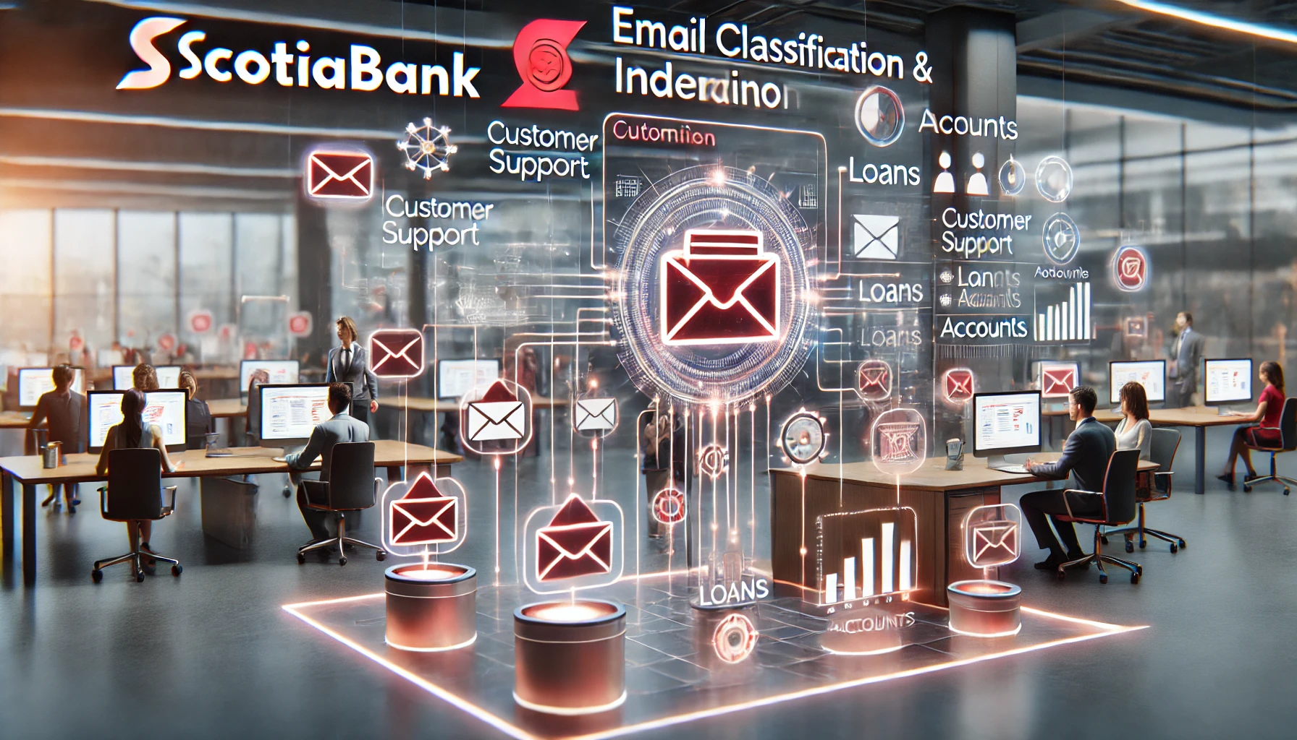
Finetuning Strategies Why Finetune?
Use Case 1: Real-Time Classification
Use Case 2: High-Accuracy Classification for Domain-Specific Needs
Benefits of Fine-Tuning:
1. Task-Specific Optimization
2. Compression Techniques 3. No Jail breaking
Benefits of Fine-Tuning:
1. Specialized Training Data
2. Improved Contextual Understanding

Slide 3
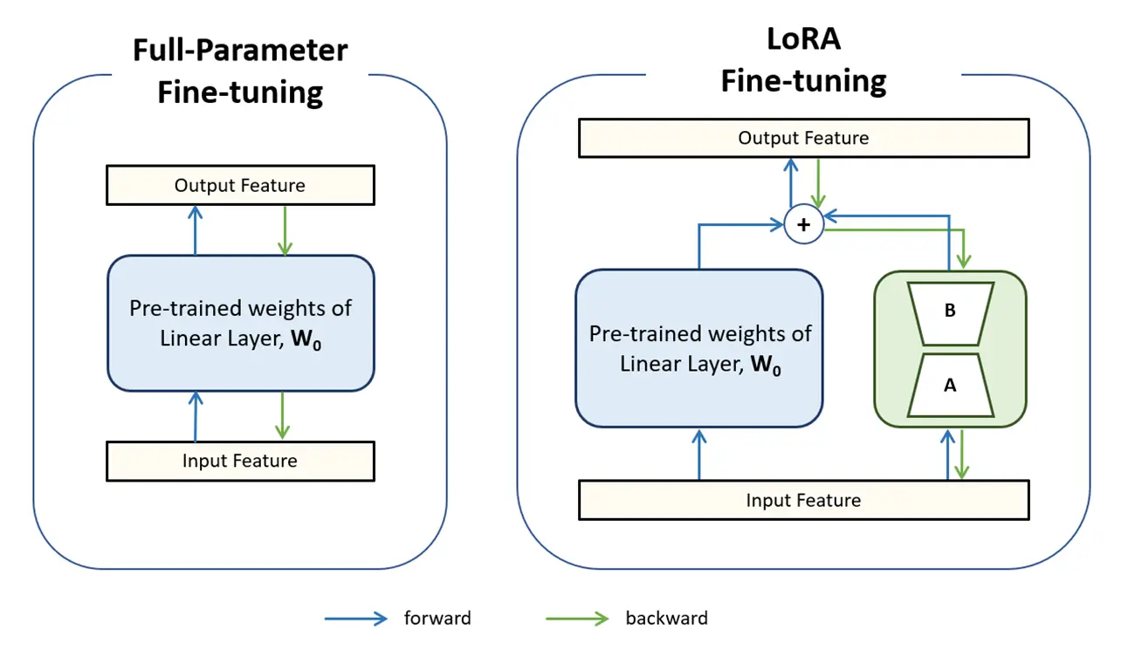
Finetuning Techniques
Fine-Tuning Small or Medium Language Models (SLMs)
Fine-Tuning Large Language Models (LLMs)

Slide 4
Indexing Automation Models
Customer Name Extraction
Email Classification
Base Model-XLM Roberta large
Data used – 4500 rows of
Base Model-DistilBertBase
Data used – 80k rows of Indexing data

Slide 5
Data Preparation for Customer Name Extraction model
Data Analysis:
Conducted an in-depth analysis of the email dataset to identify patterns and trends.
Observed that the top 1,000 senders accounted for 70% of the data. Many of these senders followed specific email formats.
Data Sampling Strategy:
To ensure coverage of variations, selected two sample emails from each of the top 1,000 senders.
Additionally, collected 2,000 sample emails from the remaining senders to include diverse formats.
Data Labeling:
Instead of labeling the data from scratch, leveraged an already fine-tuned Named Entity Recognition (NER) model as a starting point.
Manually reviewed and corrected the model's outputs to fix any errors, significantly reducing the labeling effort while maintaining accuracy
Initial Model Training:
Trained the model using the prepared dataset.
After the first iteration, it was observed that the model produced false positive (FP) results, especially in cases where emails contained no customer information.
Data Augmentation:
Identified emails with no customer data and added these cases to the training dataset to address the false positives.
Re-Training and Results:
Re-trained the model with the augmented dataset.
Achieved significantly improved accuracy with a substantial reduction in false positives.

Slide 6
Current challenges and future improvements
Exploring Gemini API for customer name extraction and matching improvements.
Using Gemini for classification in case of class split up.
Using Gemini for fax/scan cases.
Including French cases.
Improving extraction in streamlined cases.

Slide 7
Finetuning cost
Techniques Overview:
1. Fine-Tuning Large Language Models (LLMs): Adapting pre-trained LLMs for specific tasks or domains.
2. Fine-Tuning Smaller Language Models (SLMs): Leveraging smaller models for lightweight and efficient domain-specific tasks.

